Slide 1
Climate justice in adaptation policy: an evidence map and author’s gender analysis
Workshop Adaptation Tracking and AI
Diana Danilenko, 24.10.2023

Slide 2
Presentation Outline
Introduction
Motivation
Theoretical Framework
Research Questions & Hypotheses
Methods
Systematic Literature Review
Gender Prediction
Structural Topic Modelling
Quantitative Analysis
Limitations
Results
Gender Estimation
Structural Topic Modelling
Effects of Metadata
Discussion

Slide 3
“All human beings are born free and equal in dignity and rights. Yet, when it comes to the effects of climate change, there has been nothing but chronic injustice and the corrosion of human rights.”
- Mary Robinson (former United Nations High Commissioner for Human Rights,
founder of Mary Robinson Foundation Climate Justice, first woman president of Ireland)
3
Notes:
add her title

Slide 4

1.1 Introduction: Motivation
Women are disproportionately vulnerable to climate change impacts.
Currently implemented policies often have adverse effects.
IPCC AR6: 33% of the core authors are women, while male researchers persistently dominate discussions and writing.
Engaging women tends to provide for more innovative and inclusive solutions.
Women representation in national parliaments is associated with the adoption of more stringent climate policies.
Significantly reducing gender inequality enables climate resilient development.
(Nagel, 2015; Perez, 2019; Liverman et al., 2022)
(Mavisakalyan & Tarverdi, 2019; Robinson, 2019; Andrijevic et al., 2020)
Image source: (UNDP, 2022)
Introduction
Notes:
I was motivated by the theoretical or case-study feminist literature and wanted to apply a systematic evidence synthesis approach to test the concept of intersectional feminism on the climate adaptation output.
motivation to focus on scientific output instead of policy/activism assessment -> policy at its best is science informed
Improvements in gender equality are compatible with the sustainable development scenario (SSP 1 and 2), while it deteriorates under SSP 3 (Andrijevic et al., 2020)
privileged groups tend to overlook the needs of others

Slide 5

1.2 Introduction: Theoretical Framework
CLIMATE JUSTICE – a framework that, while aimed at tackling climate change, prioritises human rights by explicitly addressing multiple intersecting injustices that are or can be made worse by the absence or delay or misguided implementation of mitigation and adaptation activities, or even by their implementation.
(Robinson, 2011; Sultana, 2021).
FUNDAMENTAL PRINCIPLES
distributive justice (how resources are allocated among individuals, nations and generations);
procedural justice (the inclusivity of the decision-making process); and
recognition (focuses on the representation of diverse cultures and perspectives in the form of either direct engagement or indirect but fair consideration).
(IPCC, 2022)
Introduction

Slide 6
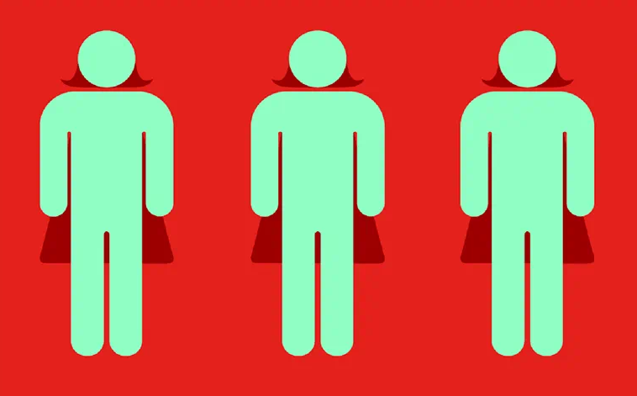
3. Research Questions
Hypotheses
RQ: Do women authors tend to include a topic related to climate justice in their research more often than men authors?
H0: There is no statistically significant difference in topic prevalence regarding climate justice topics between female and male researchers.
H1: Female researchers in the position of the first author include social justice topics in their research on climate change adaptation policy more often than male researchers in the same position.
Image source:
(Criado Perez, 2020)
Research Questions & Hypotheses
Notes:
Representing a minority in terms of social and economic power, women are believed to be more responsive
Based on the theoretical literature on the complacency of non-marginalised groups, as well as the evidence from empirical studies that address gender disparities across subfields of scholarship and intersectionality in climate governance, the following hypotheses have been formulated:

Slide 7
4. Methods: Overview
Dataset compilation
Gender prediction
Evidence mapping
Analysis & Interpretation
Implement query
Drop missing names and initials
Drop missing values for control variables
Year,
Gender Inequality Index,
Journal Impact Factor
Calculate effects
Web of Science
(n = 44685)
Scopus
(n = 54140)
Estimate differences
first
(n = 43115)
last
(n = 43107)
all
(n = 41157)
first
(n = 31422)
last
(n = 32873)
all
(n = 22266)
Reduce dimensionality with t-SNE
Deduplicate and remove empty records
Estimate gender
topic prevalence
Initial dataset
(n = 70319)
Evaluate topic models at different K values
first
(n = 37482)
last
(n = 38090)
all
(n = 25876)
Extract topic prevalence matrices at chosen K
Methods
Notes:
add clicking so they appear one by onw

Slide 8
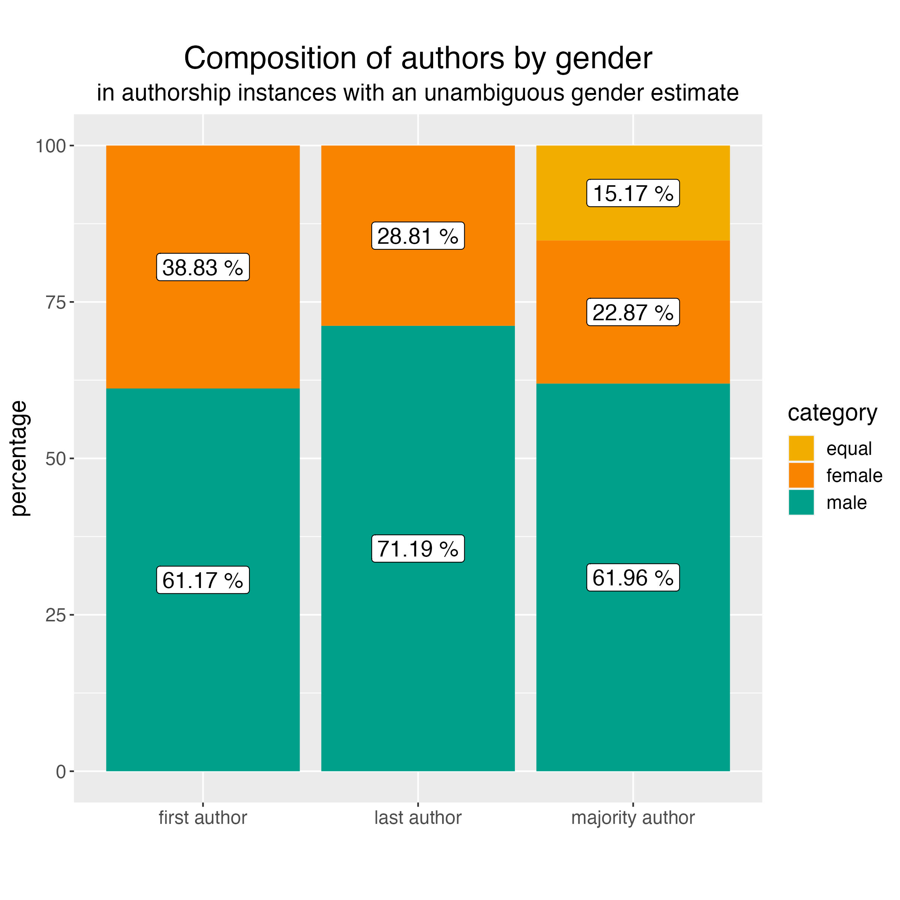
5.1 Results: Gender Estimation
The last author position is largely held by men researchers, which illustrates once again the ‘leaky pipeline’ problem, where gender parity is lower in higher career stages.
We observe a higher women participation rate than for the most scientific disciplines described before.
There is a clear gender bias in collaboration patterns.
Results
Notes:
Except for the subfields in medical research related to ‘care’ and veterinary medicine or, in sociology, - family and gender.
Figure 1. Relative representation of female and male authors for the first and last authorship instances, as well as for the majority in a research group for the climate change adaptation policy scholarship. The numbers are provided as percentages from the authorship instances where an unambiguous gender estimate could be assigned.
From the women first authors, 41,75% published with a female supervisor.
Among the men first authors, only 22,85% published with a female supervisor.
Inversely, 54,09% of female supervisors worked with a female first author, whereas only 32,70% of male supervisors published with a female first author.
Only 7,32% of male supervisors published with research teams where the majority of authors were women, compared to 58,68% of female supervisors.

Slide 9
5.2 Results: Structural Topic Modelling
Results
Notes:
we have identified 13 topics as related to the conceptual framework of climate justice
we can clearly see that some topics are very "gendered“
some topics associated with the framework are not present at all (i.e. inequality on the basis of race/ethnicity)
The ‘climate justice’ topics appear to be rather tightly related, even in a 2-D representation of the topical space.

Slide 10
5.2 Results: Structural Topic Modelling
Results

Slide 11
5.2 Results: Structural Topic Modelling
Results

Slide 12
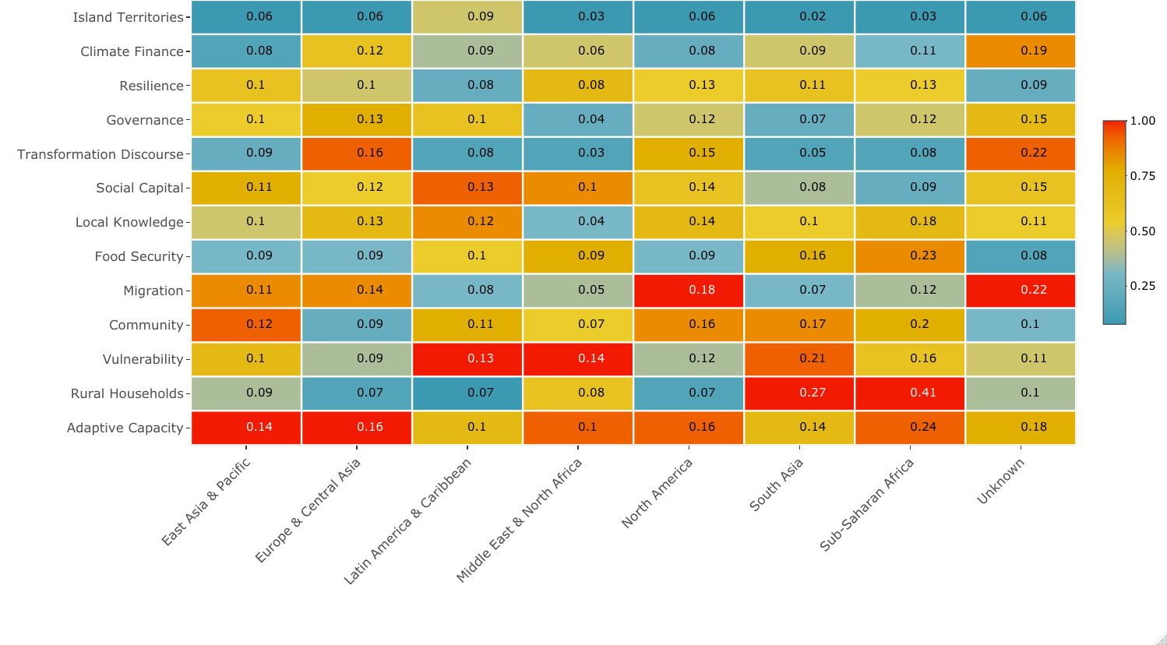
5.2 Results: Structural Topic Modelling
Results

Slide 13
5.3 Results: Effects of Gender Variables
Results
Notes:
for 7 out of 13 topics we find significant positive effects
8/13
8/13
the observed effects are larger for last and majority author gender

Slide 14
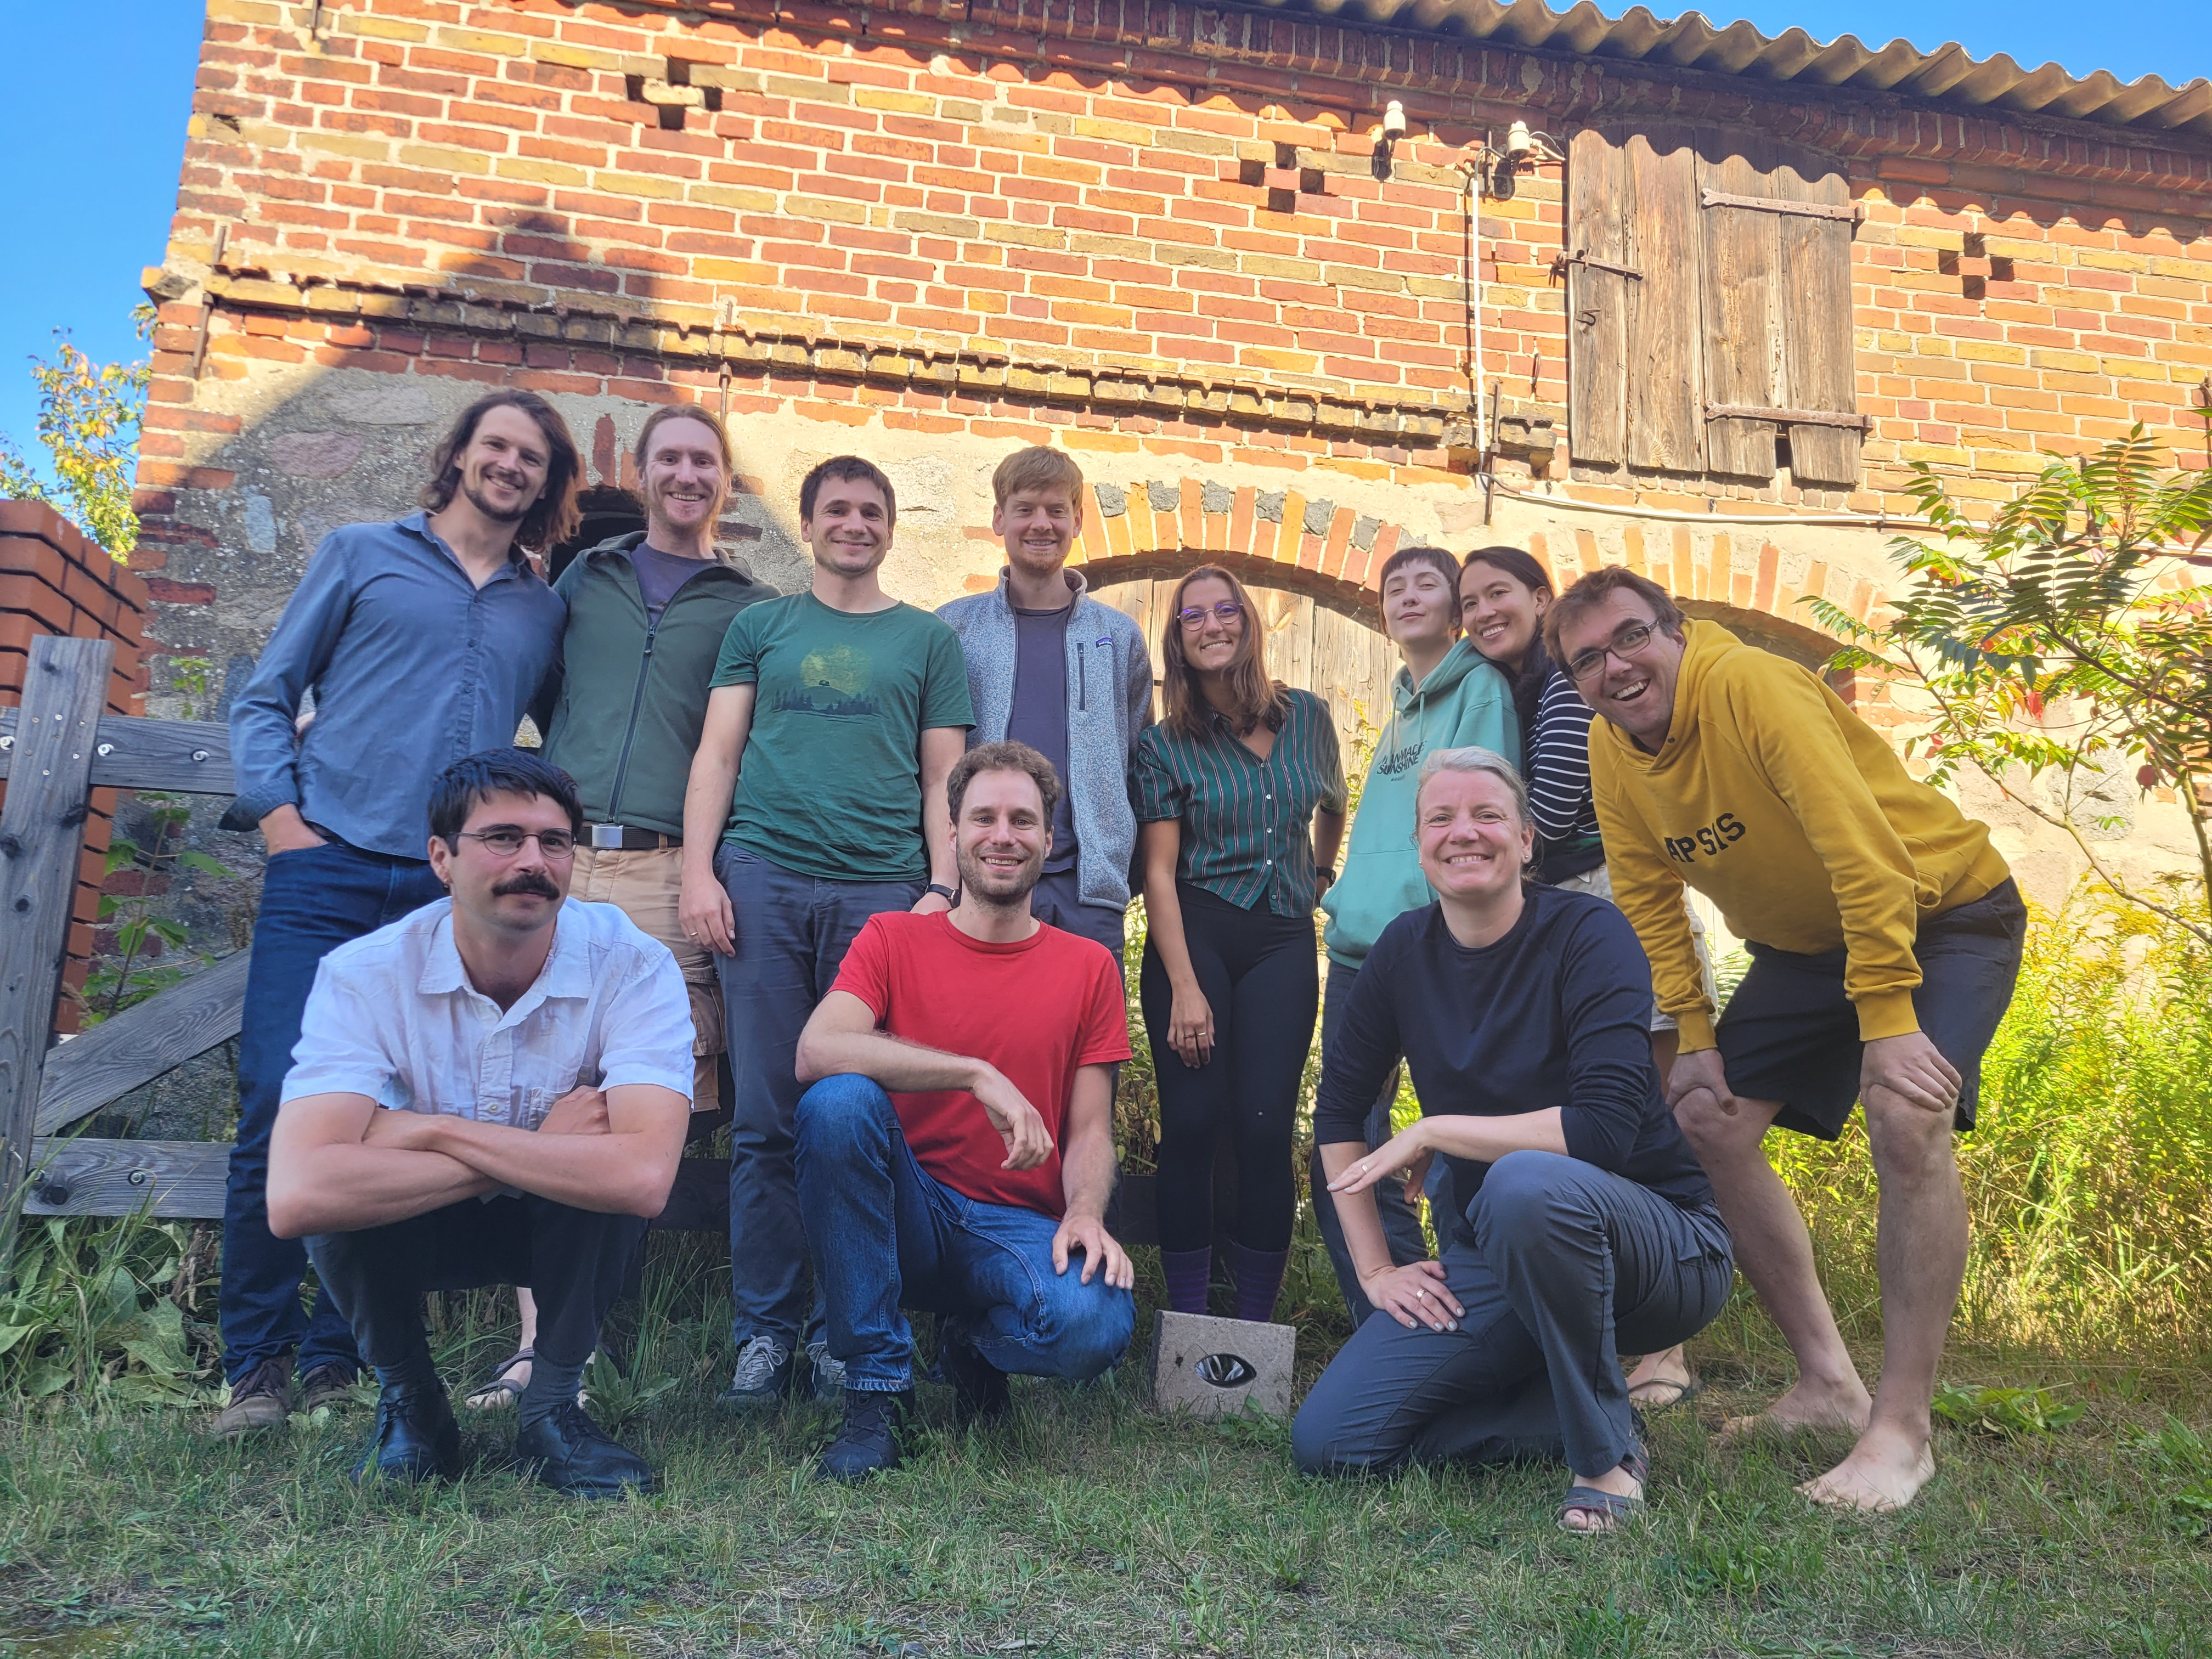
Thank you! danilenko@mcc-berlin.net

